Slide 1
Hiding a Message in CSS
By Sam Schaefer

Slide 2
Overview
About CSS
Methods used to hide a message in CSS
Failures of these methods
Method used
Limitations
Future
Summary

Slide 3
CSS
Cascading style sheets
#id {
width: 200px;
}
.class {
font-size: 1em;
}
The last style read determines the style.

Slide 4
Hiding the LSB
HW #1 Hide a message in the LSB of a pixel
Lets try to hide the LSB in the CSS elements of a webpage.
But where should we hide the message…?

Slide 5
How about…
In the FONT-SIZE
em =Relative to the font-size of the element (2em means 2 times the size of the current font)
So if you have a font size of 1em and you make it 1.001 em you really won’t see a difference.

Slide 6

ISSUE
Well a vast amount of webpages don’t have that many varying font sizes.
The webpage I made for testing this has around 4 different font sizes.
So I can hide up to 4 bits!
Half a byte…

Slide 7
Well maybe…
Extend em floating point size to…
1.0000000000000000000000000
Hide 3 bytes per font size
1.0110010010011100111001100
This works, but then you have a ton of fonts with a trail of 1’s and 0’s. Looks a little odd!

Slide 8
Hide in IDs
Websites tend to have a fair amount of IDs.
<div id=“example”></div>
My testing webpage, (which in tiny) has 27 ids on the front page.
I can hide a total of 3 bytes in those ids.
My testing webpage can hold a 2 or 3 letter words.

Slide 9
Method to Hide
Classes don’t look suspicious in CSS.
Create two different classes to represent 0 and 1
Take the message you wish to hide and turn it into ASCII. Now split result into it’s binary representation of 0’s and 1’s.
Grab all of the IDs on a webpage.
Inject the class representing 0 or 1 into the IDs, hiding your message.

Slide 10
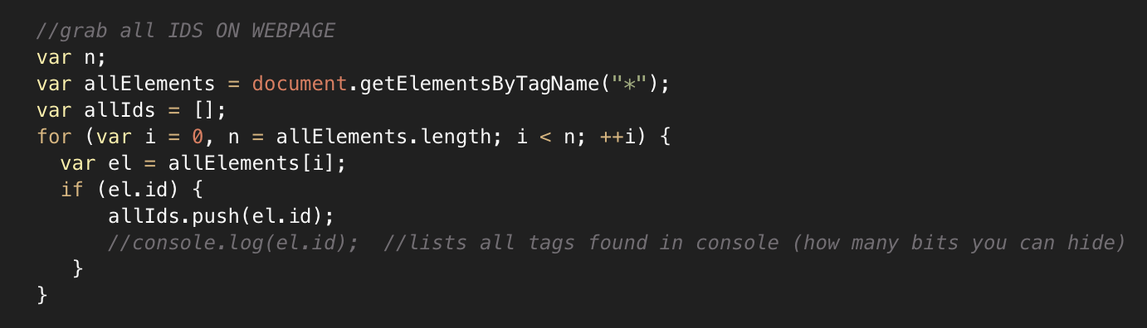
Code Snip

Slide 11
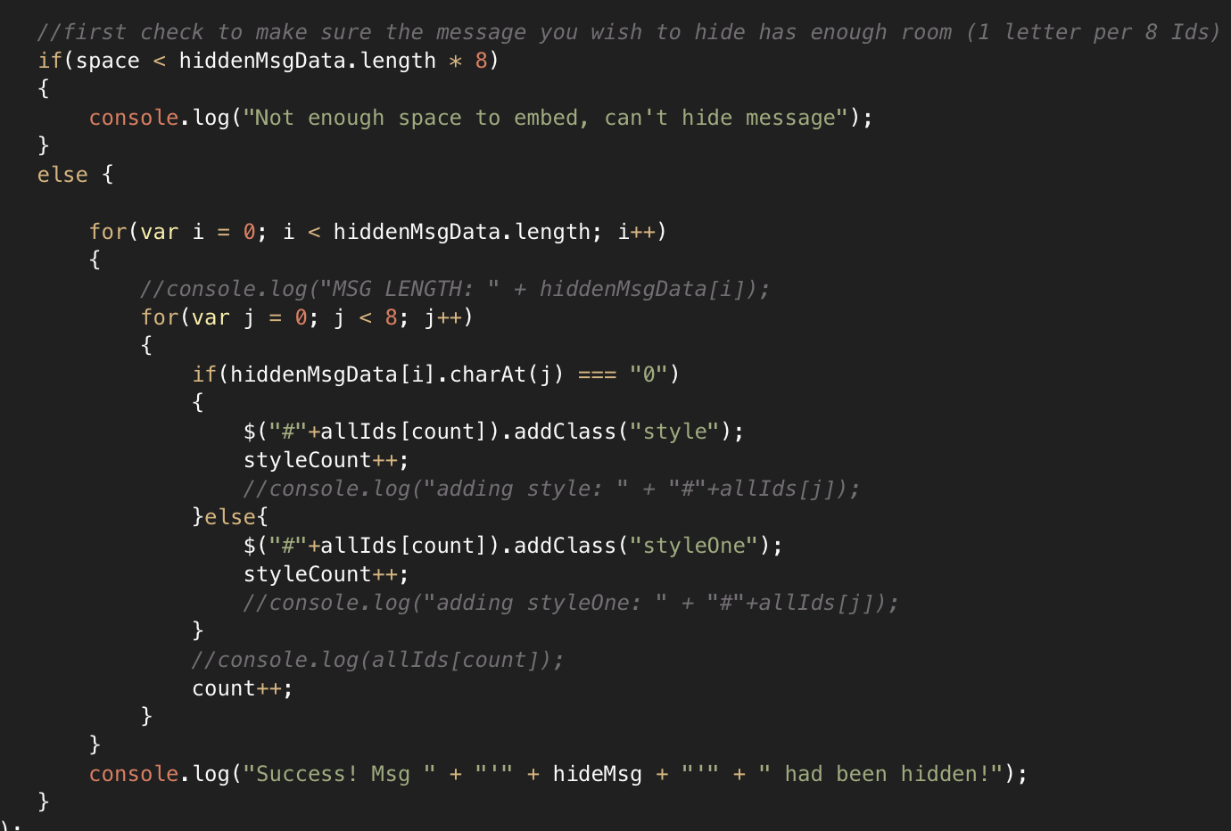
Code Snip

Slide 12
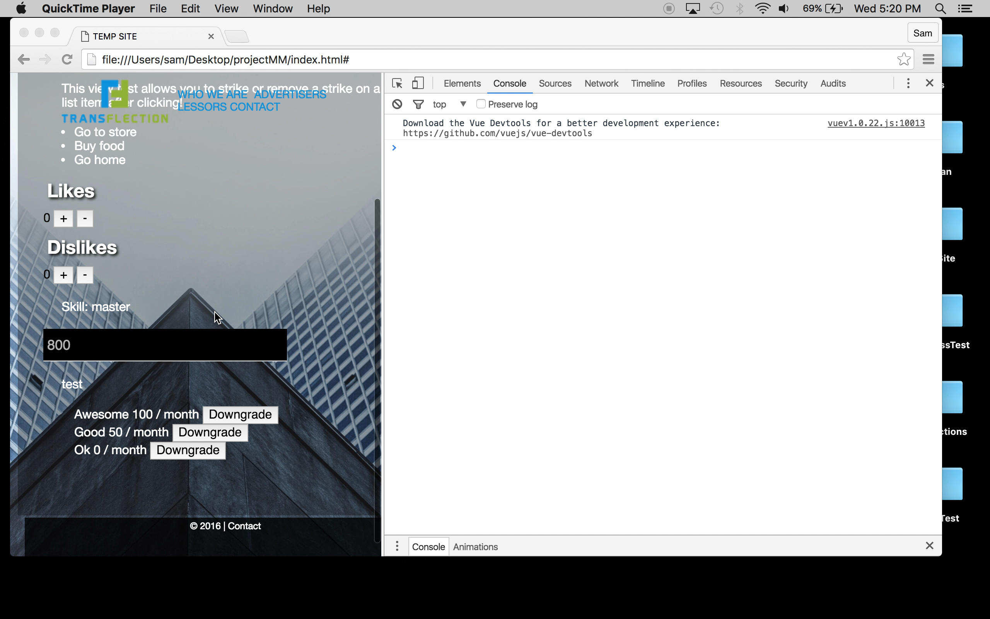
Hide / Grab Video

Slide 13
Extraction
Grab all of the IDs and place them into an array
Loop the IDs looking at the class associated with them and place this into an array
Take the string of 0’s and 1’s and convert it into an ASCII value
Convert this into a String letter and place into an array
Print the array

Slide 14
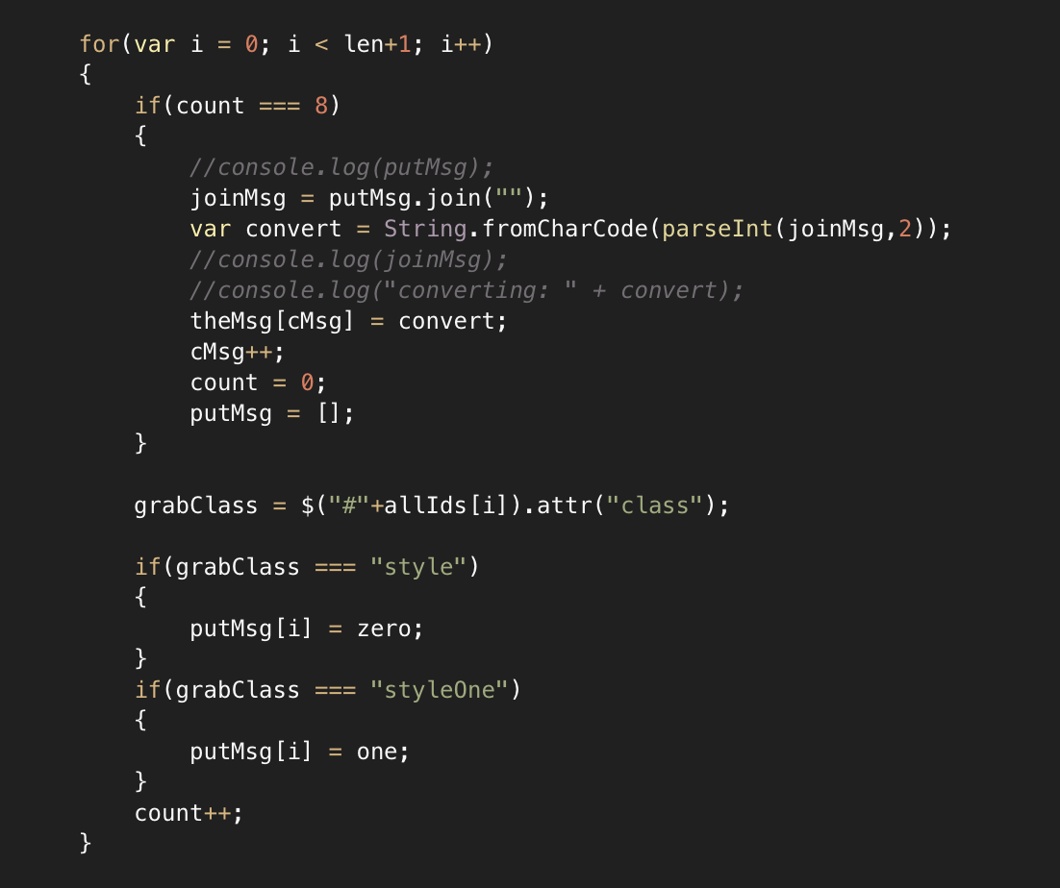
Code Snip

Slide 15
Future Method
Hide in font-size em within an injected class.
Only inject into IDs without a font-size so it doesn’t distort the webpage. Take the desired size of message to be hidden and extent out the amount of available IDs font-size em floating point to hold the message size.

Slide 16
Summary
If your message is one word, this method might work for you!
This method isn’t secure, anyone could view the html/css and see the classes injected. However, it looks just like bad practice.
Once someone figures out what the class names represent, they can crack your messages.
If your message is sensitive, do not use this method!

